Slide 1

People Who Chose “Other”As Job Title
A Summarization of the Answers Given by People Who Chose Other As Job Title from the Survey Done by Kaggle in 2017,2018,2019

Slide 2
Read Before You Continue
Some Points To Address:
1) The Sheets Are In the Same Order As the Answers.
2) The Answers For Questions 2,3,5,6,8 Are in an Excel File That is in the Same Folder As This PowerPoint File
3) Click The Link placed on the Numbers Behind The Questions To Get to the Page That Contains The Answer
4) The Data For Questions 21 Was Unusable So the Question Was Skipped.
5) The Labels Are Proportionate to the Values(Make Sure To Check Labels If You Are Comparing Between Professions).
6) This Was A Long Project So I Apologize For Any Typos.

Slide 3




Objectives
Locate The Most Popular Tools Among Professionals
Check Their Recommendations To Locate The Most Useful Tools
Understand Which Tools Are in High Demand in the Market

Slide 4
The Questions
Begin From here
1) What is your age? | 2) What is your gender? | 3) In which country do you currently reside? | 4) What is the highest level of formal education that you have attained or plan to attain within the next 2 years?
5) Select the title most similar to your current role (or most recent title if retired) | 6) For how many years have you been writing code and/or programming? | 7) What programming languages do you use on a regular basis? (Select all that apply | 8) What programming language would you recommend an aspiring data scientist to learn first?
9) Which of the following integrated development environments (IDE's) do you use on a regular basis? | 10) Which of the following hosted notebook products do you use on a regular basis? (Select all that apply) | 11) What type of computing platform do you use most often for your data science projects? | 12) Which types of specialized hardware do you use on a regular basis? (Select all that apply
13) Approximately how many times have you used a TPU (tensor processing unit)? | 14) What data visualization libraries or tools do you use on a regular basis? (Select all that apply) | 15) For how many years have you used machine learning methods? | 16) Which of the following machine learning frameworks do you use on a regular basis? (Select all that apply)

Slide 5
The Questions
Begin From here
17) Which of the following ML algorithms do you use on a regular basis? (Select all that apply) | 18) Which categories of computer vision methods do you use on a regular basis? (Select all that apply) | 19) Which of the following natural language processing (NLP) methods do you use on a regular basis? (Select all that apply) | 20) What is the size of the company where you are employed?
22) Does your current employer incorporate machine learning methods into their business? | 23) Select any activities that make up an important part of your role at work: (Select all that apply) | 24) What is your current yearly compensation (approximate $USD)? | 25) Approximately how much money have you (or your team) spent on machine learning and/or cloud computing services at home (or at work) in the past 5 years (approximate $USD)?
26A) Which of the following cloud computing platforms do you use on a regular basis? (Select all that apply) | 27A) Do you use any of the following cloud computing products on a regular basis? (Select all that apply) | 28A) Do you use any of the following machine learning products on a regular basis? (Select all that apply) | 29A) Which of the following big data products (relational databases, data warehouses, data lakes, or similar) do you use on a regular basis? (Select all that apply)
30) Which of the following big data products (relational database, data warehouse, data lake, or similar) do you use most often? | 31A) Which of the following business intelligence tools do you use on a regular basis? (Select all that apply) | 32) Which of the following business intelligence tools do you use most often? | 33A) Do you use any automated machine learning tools (or partial AutoML tools) on a regular basis? (Select all that apply)

Slide 6
The Questions
Begin From here
34A) Which of the following automated machine learning tools (or partial AutoML tools) do you use on a regular basis? (Select all that apply) | 35A) Do you use any tools to help manage machine learning experiments? (Select all that apply | 36) Where do you publicly share or deploy your data analysis or machine learning applications? (Select all that apply) |  | 37) On which platforms have you begun or completed data science courses? (Select all that apply)
38) What is the primary tool that you use at work or school to analyze data? (Include text response) |  |  | 39) Who/what are your favorite media sources that report on data science topics? (Select all that apply)

Slide 7
Supplementary Questions
Begin From here
26B) Which of the following cloud computing platforms do you hope to become more familiar with in the next 2 years? | 27B) In the next 2 years, do you hope to become more familiar with any of these specific cloud computing products? (Select all that apply) | 28B) In the next 2 years, do you hope to become more familiar with any of these specific machine learning products? (Select all that apply) | 29B) Which of the following big data products (relational databases, data warehouses, data lakes, or similar) do you hope to become more familiar with in the next 2 years? (Select all that apply)
31B) Which of the following business intelligence tools do you hope to become more familiar with in the next 2 years? (Select all that apply) | 33B) Which categories of automated machine learning tools (or partial AutoML tools) do you hope to become more familiar with in the next 2 years? (Select all that apply) | 34B) Which specific automated machine learning tools (or partial AutoML tools) do you hope to become more familiar with in the next 2 years? (Select all that apply) | 35B) In the next 2 years, do you hope to become more familiar with any of these tools for managing ML experiments? (Select all that apply)

Slide 8
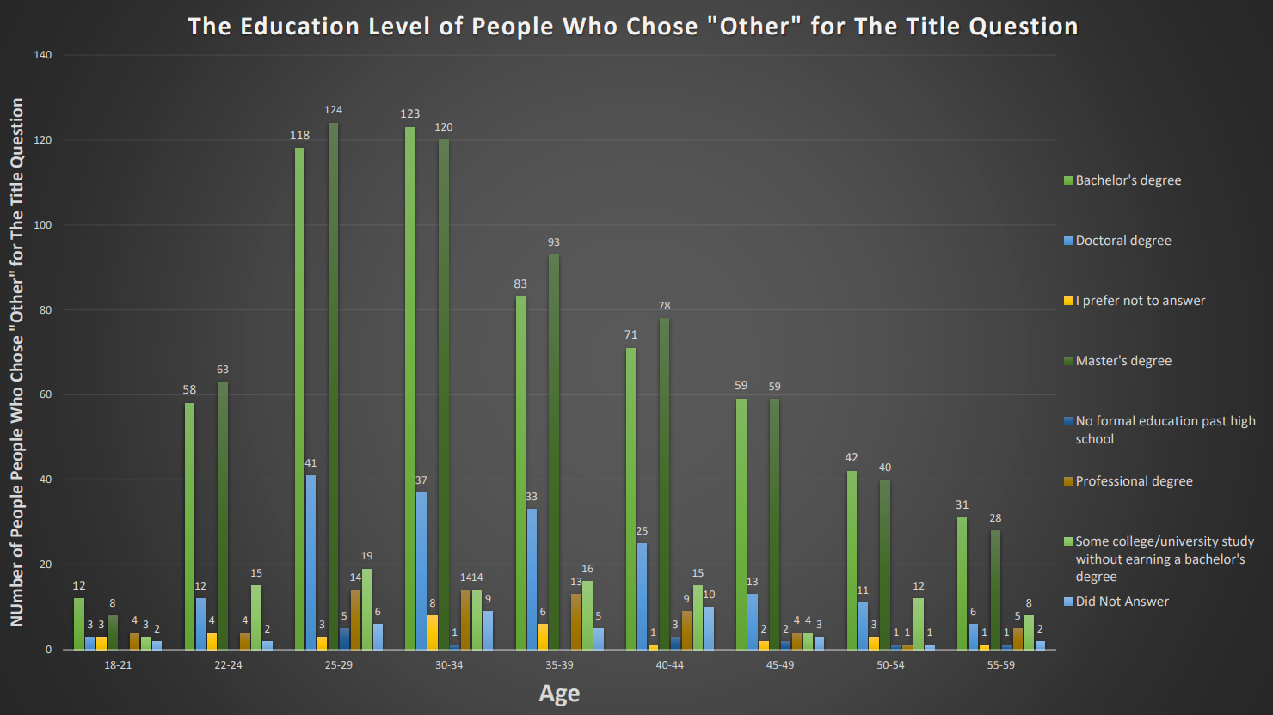

Slide 9
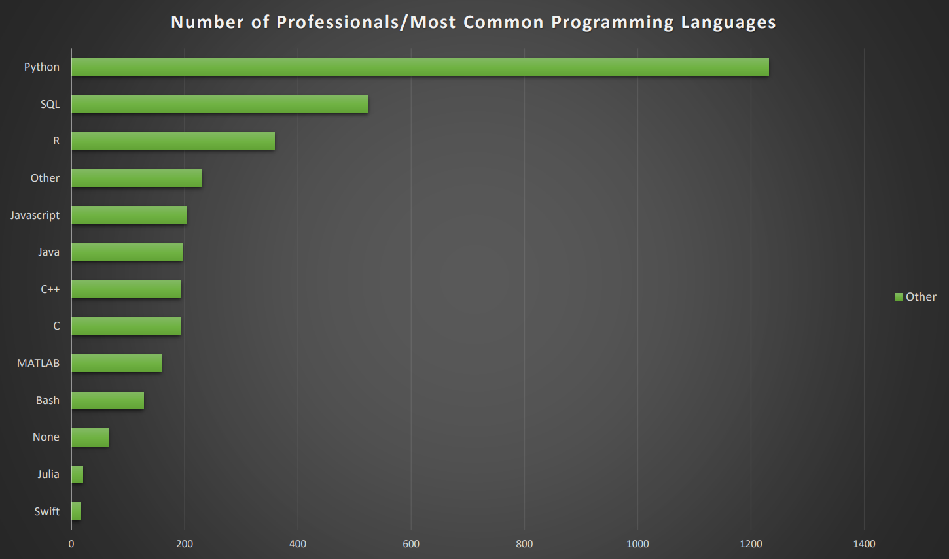

Slide 10
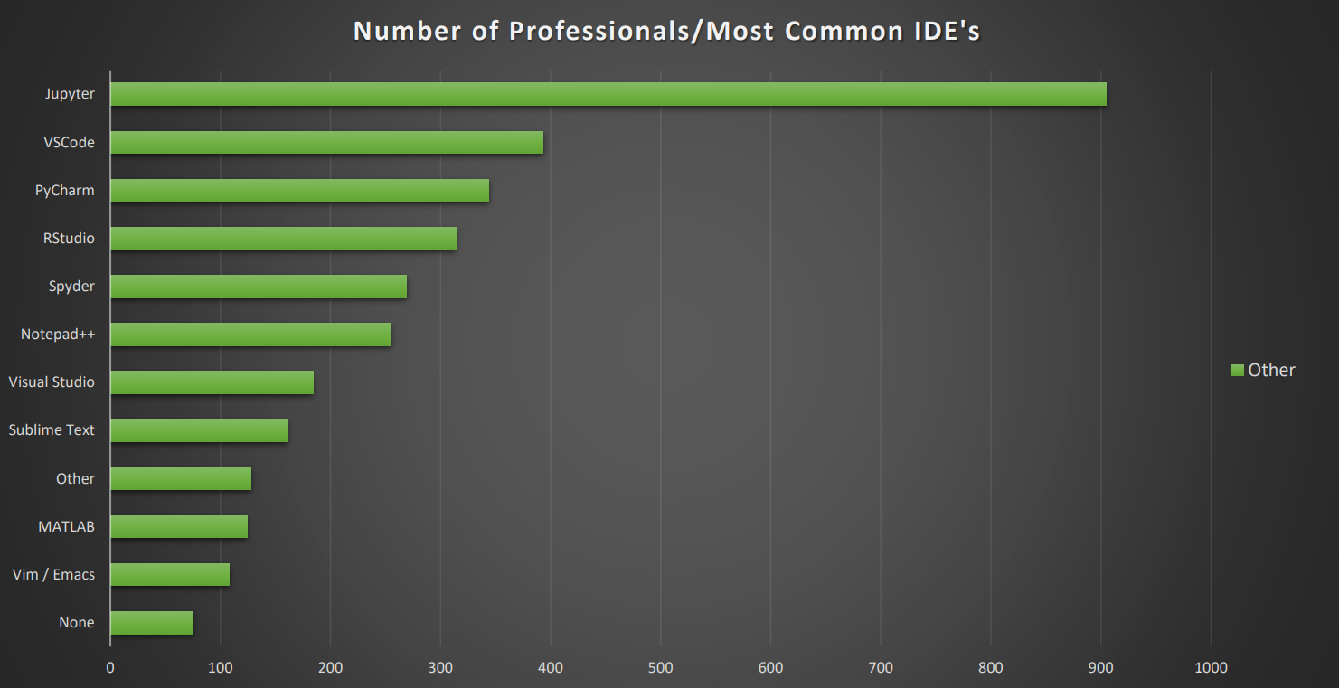

Slide 11
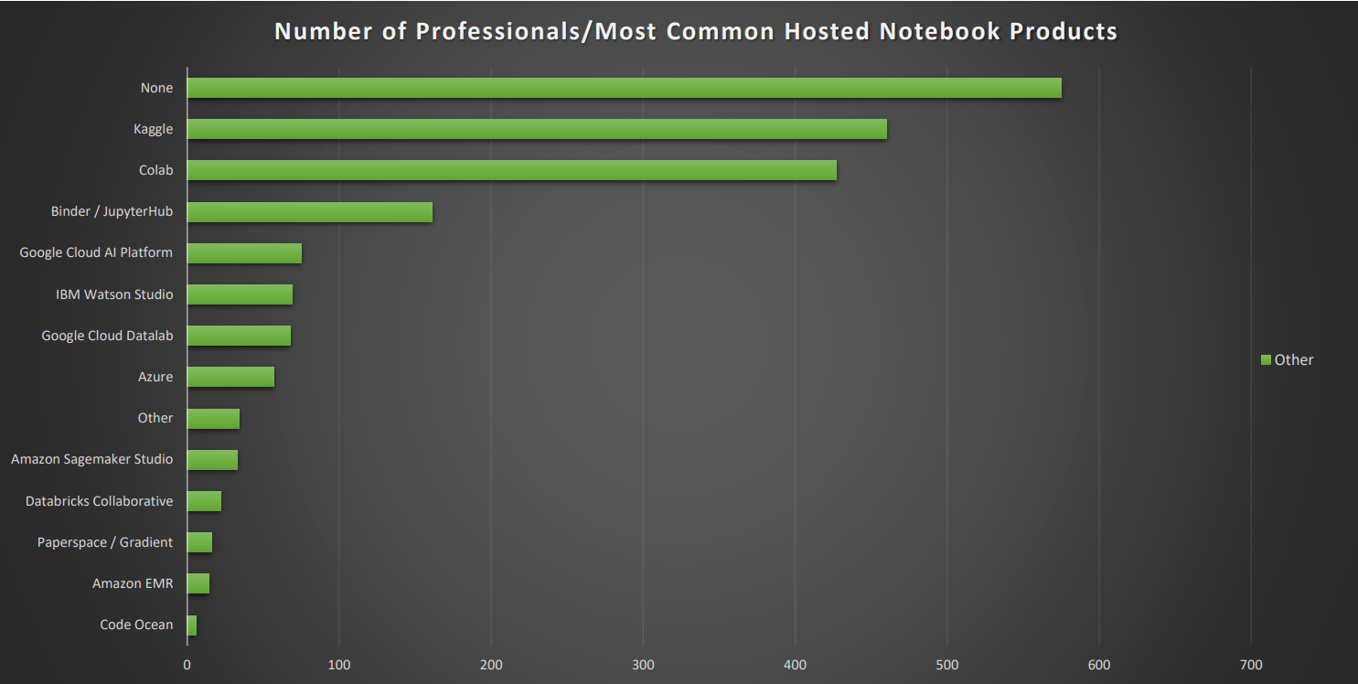

Slide 12
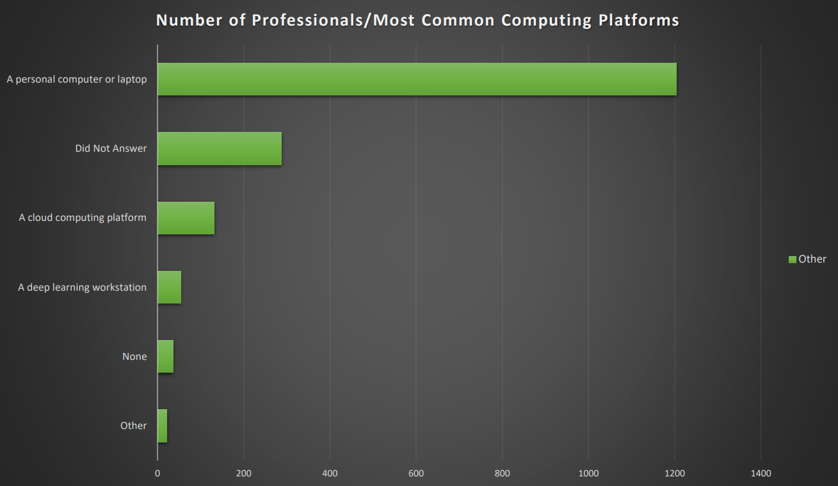

Slide 13
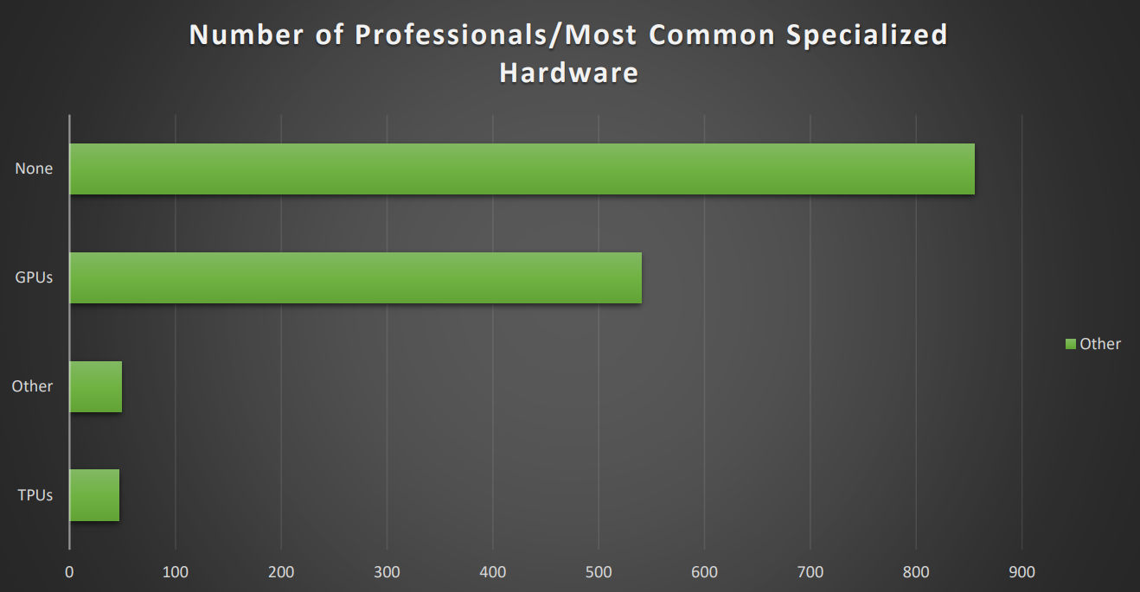

Slide 14
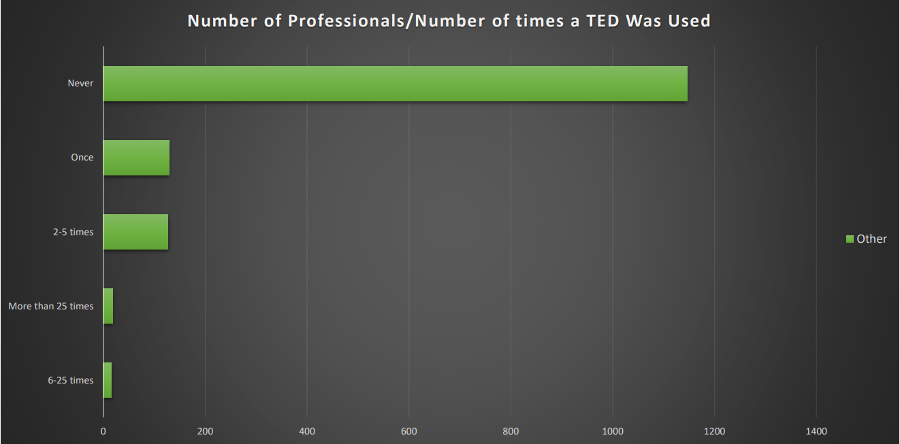

Slide 15
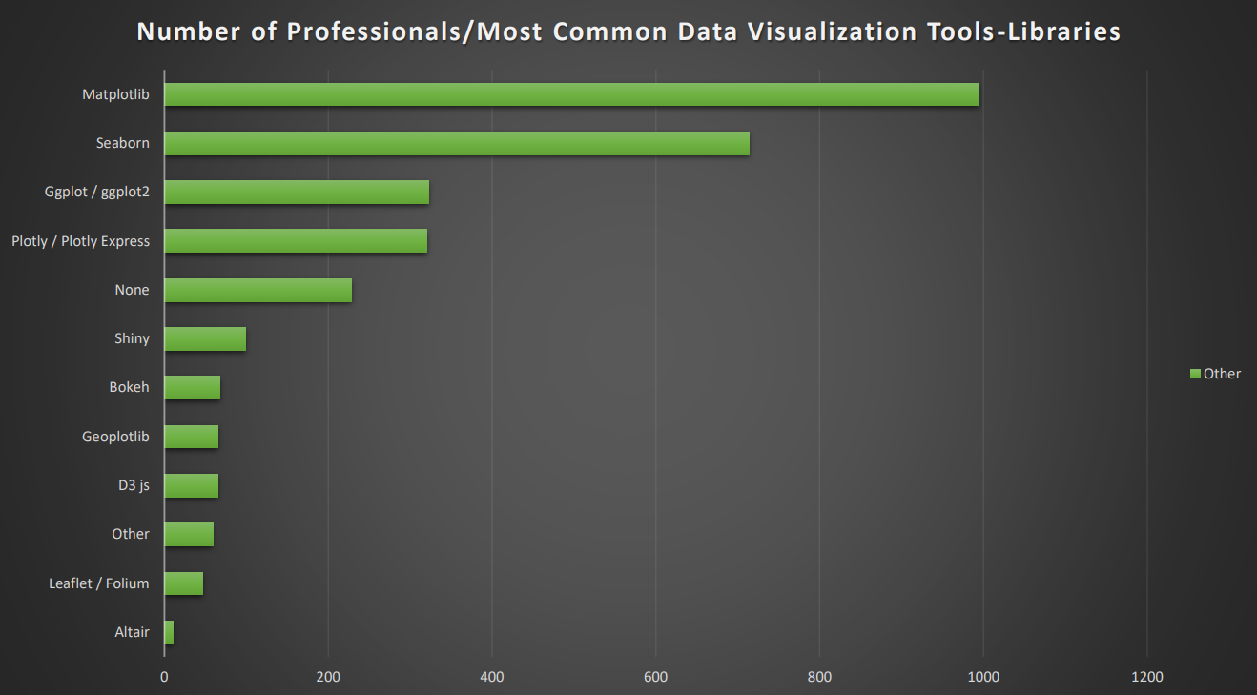

Slide 16
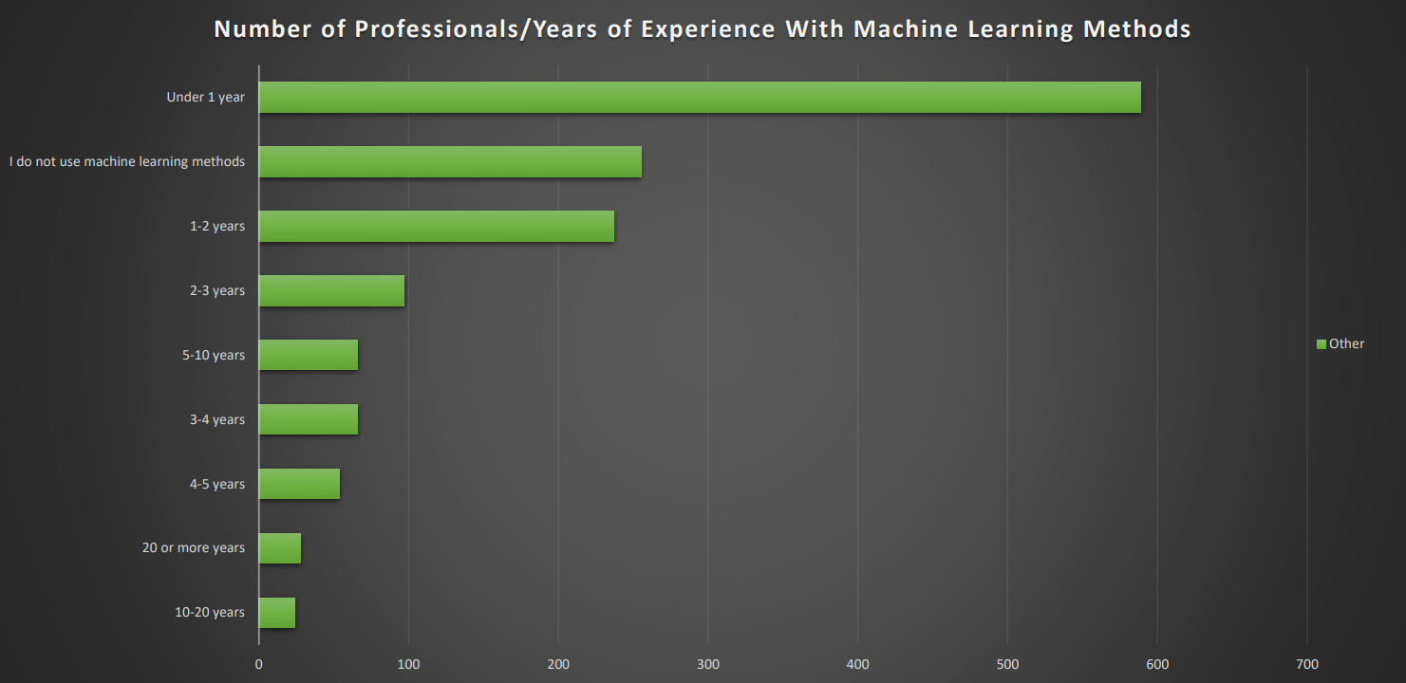

Slide 17
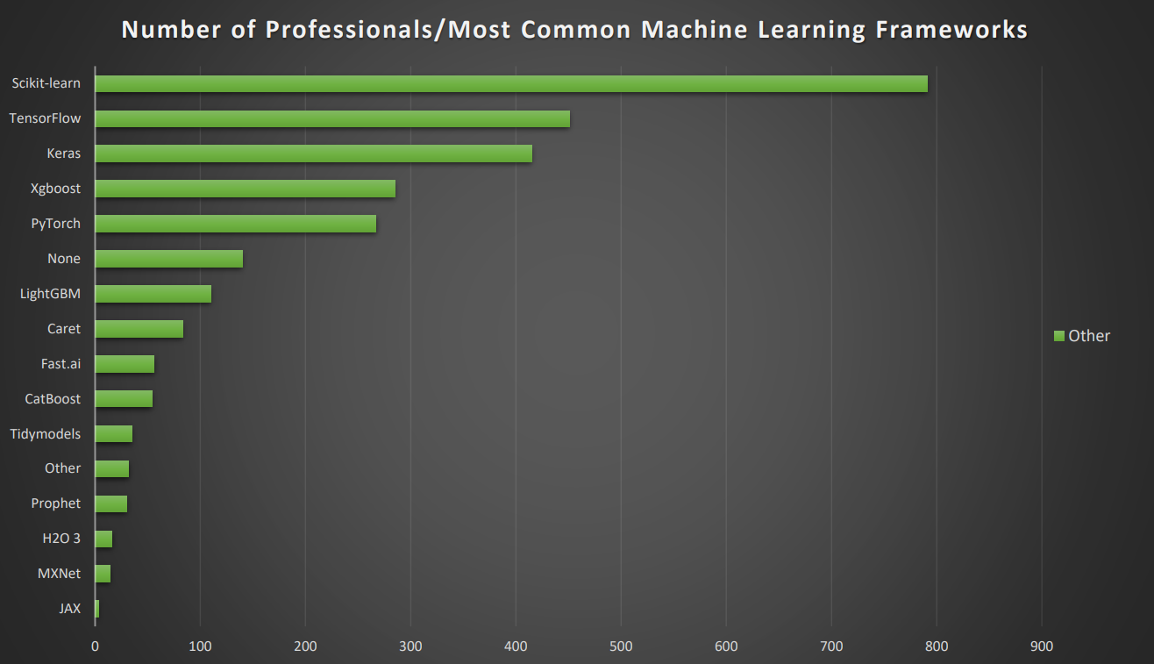

Slide 18
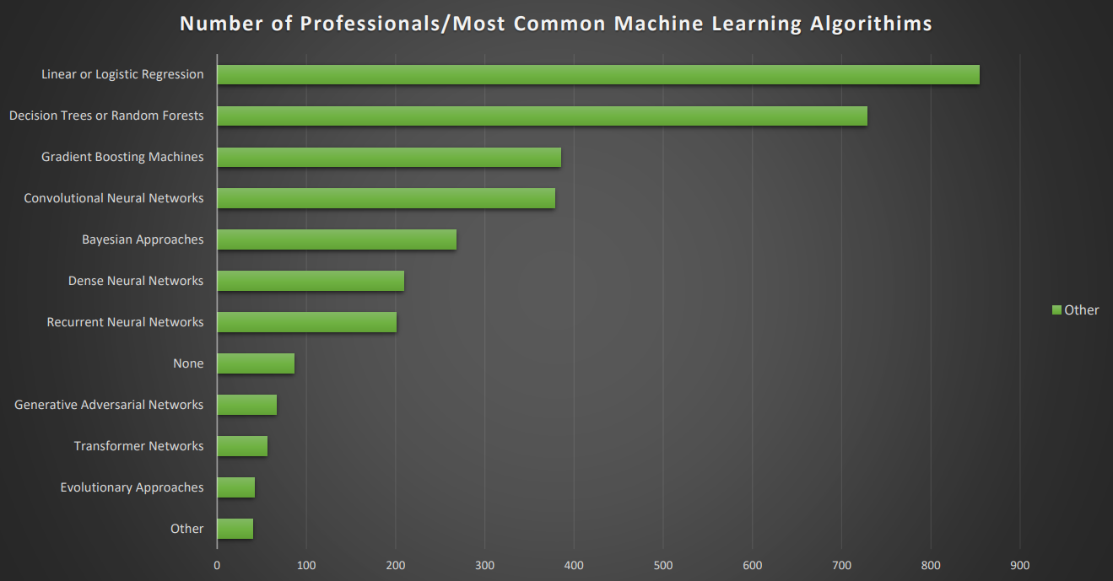

Slide 19
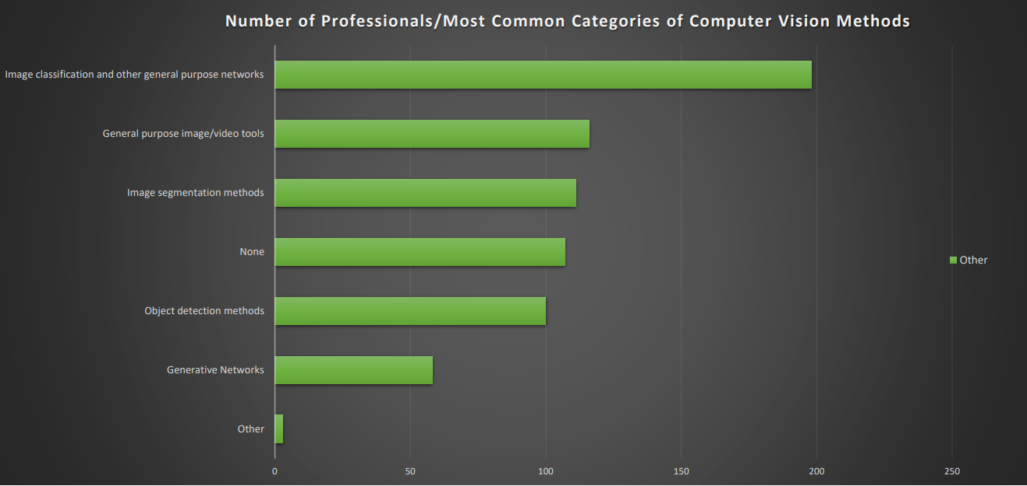

Slide 20
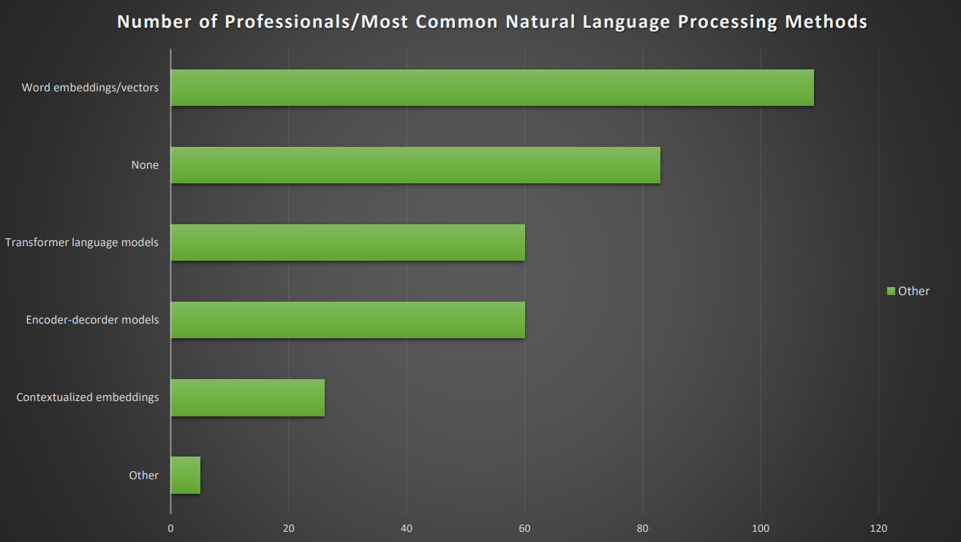

Slide 21
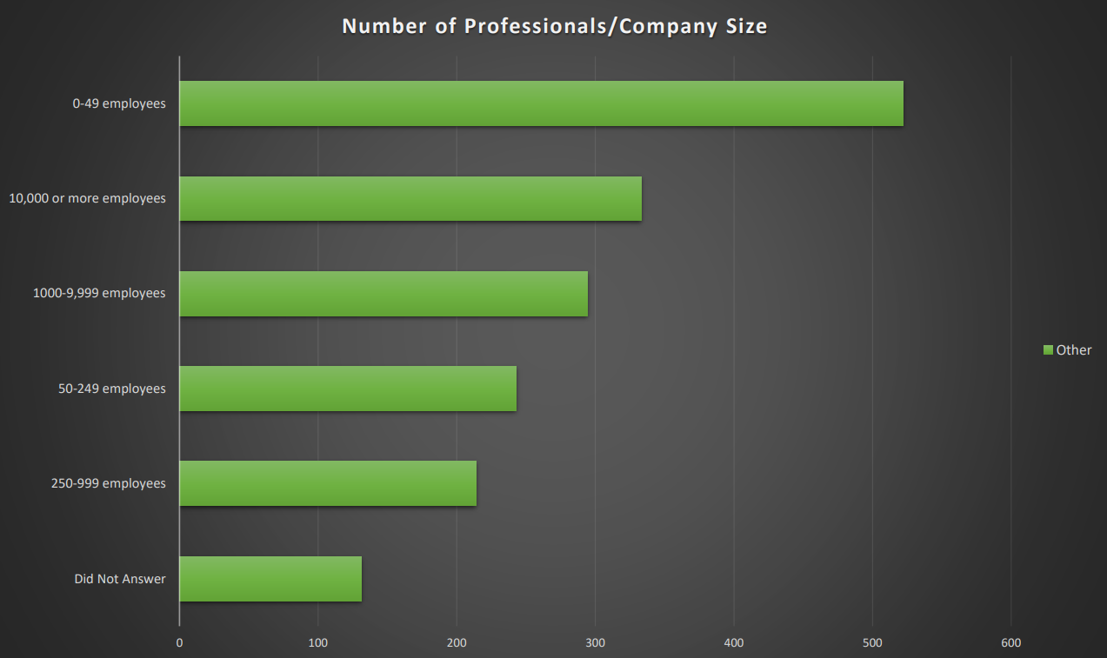

Slide 22
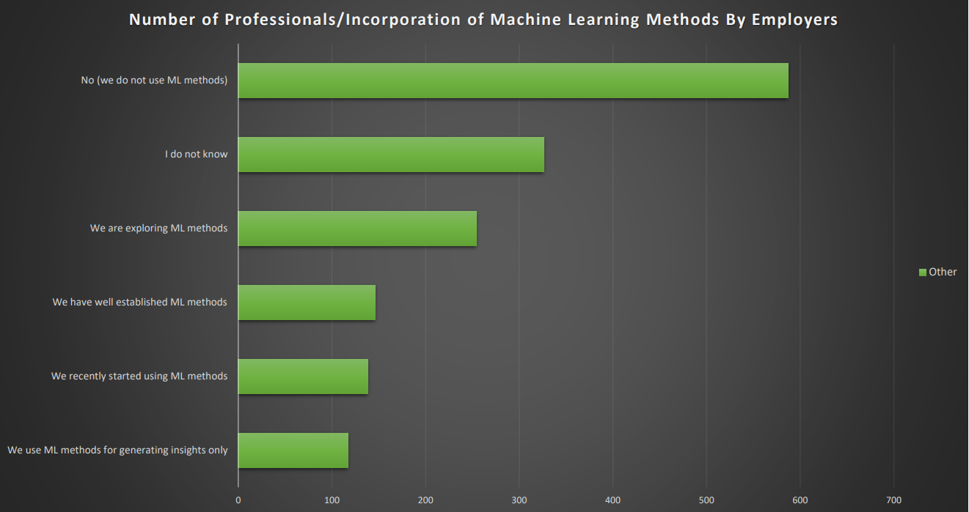

Slide 23
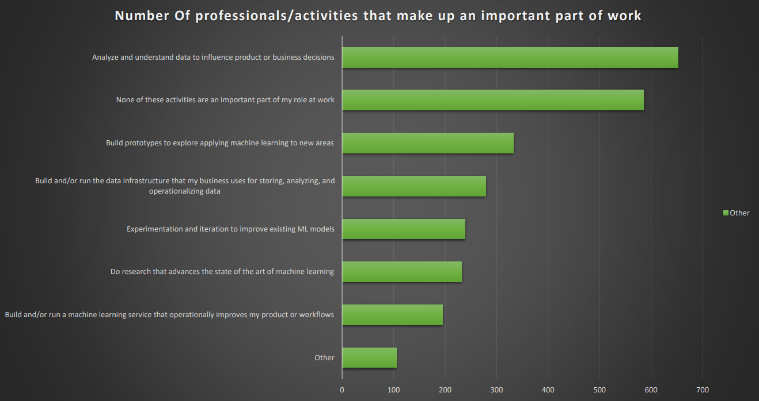

Slide 24
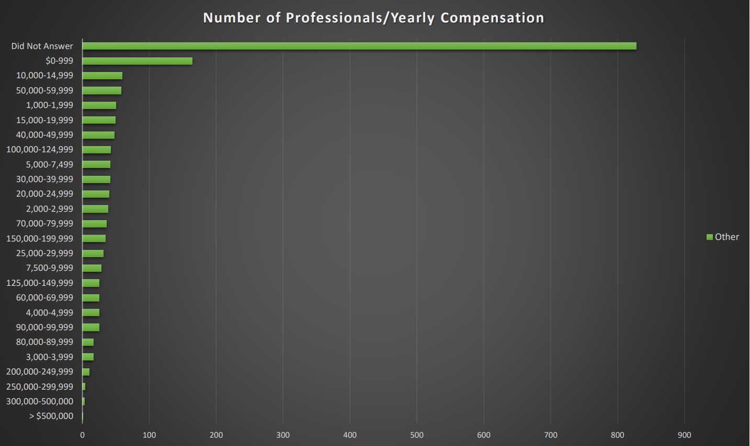

Slide 25
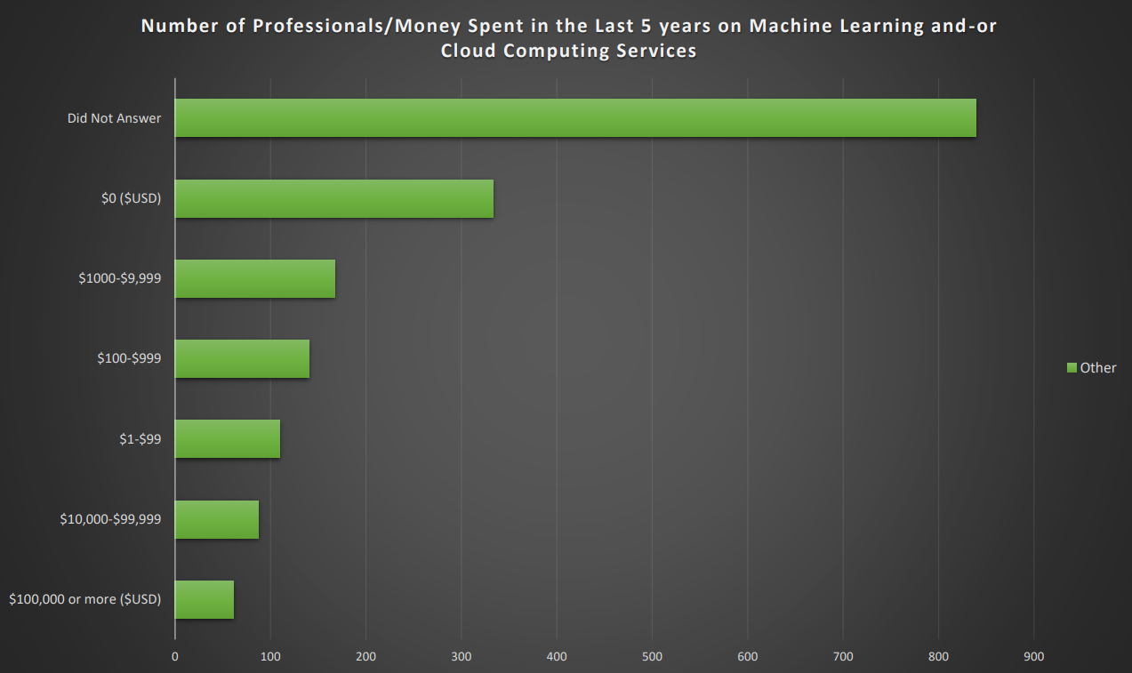

Slide 26
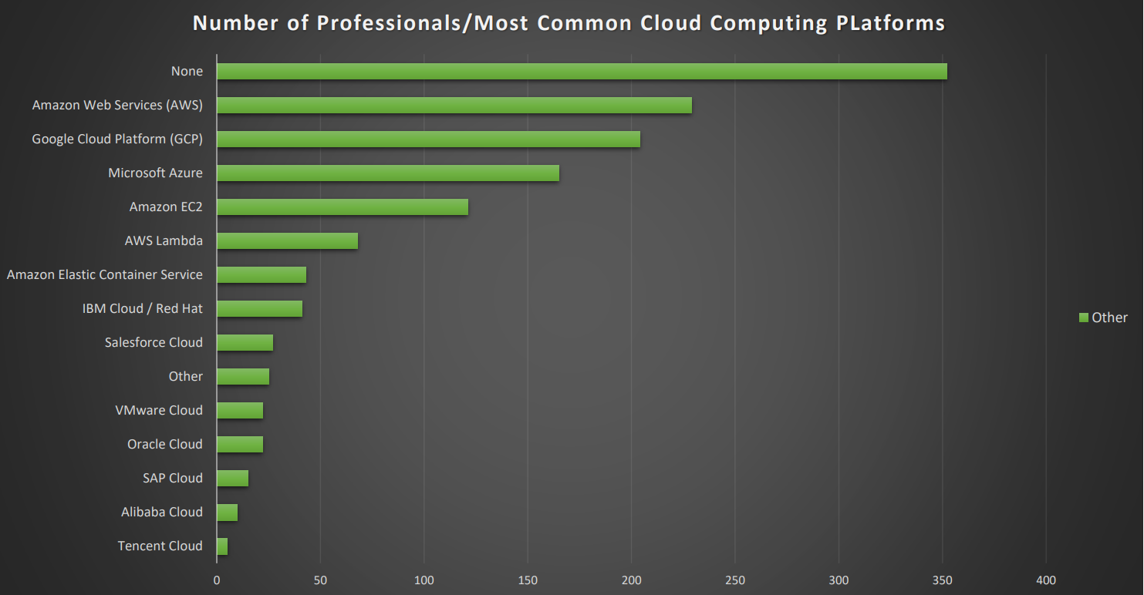

Slide 27
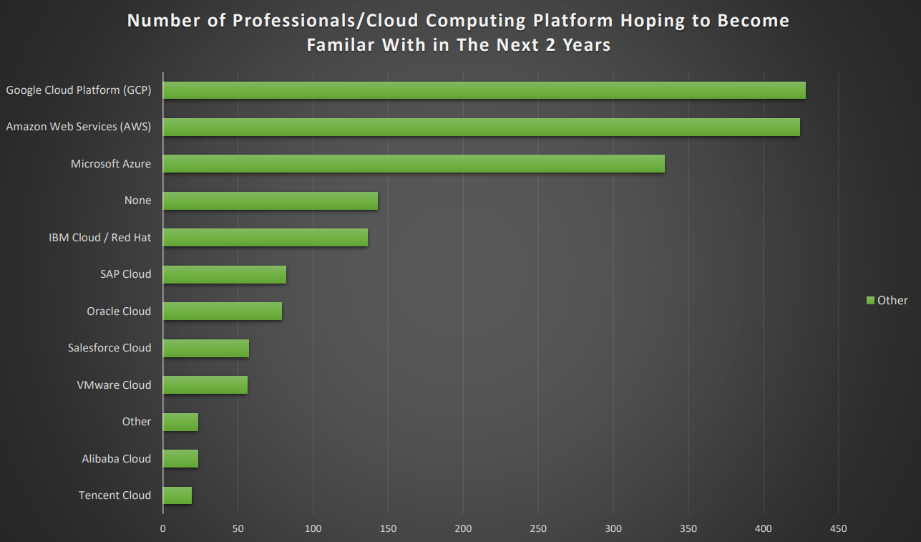

Slide 28
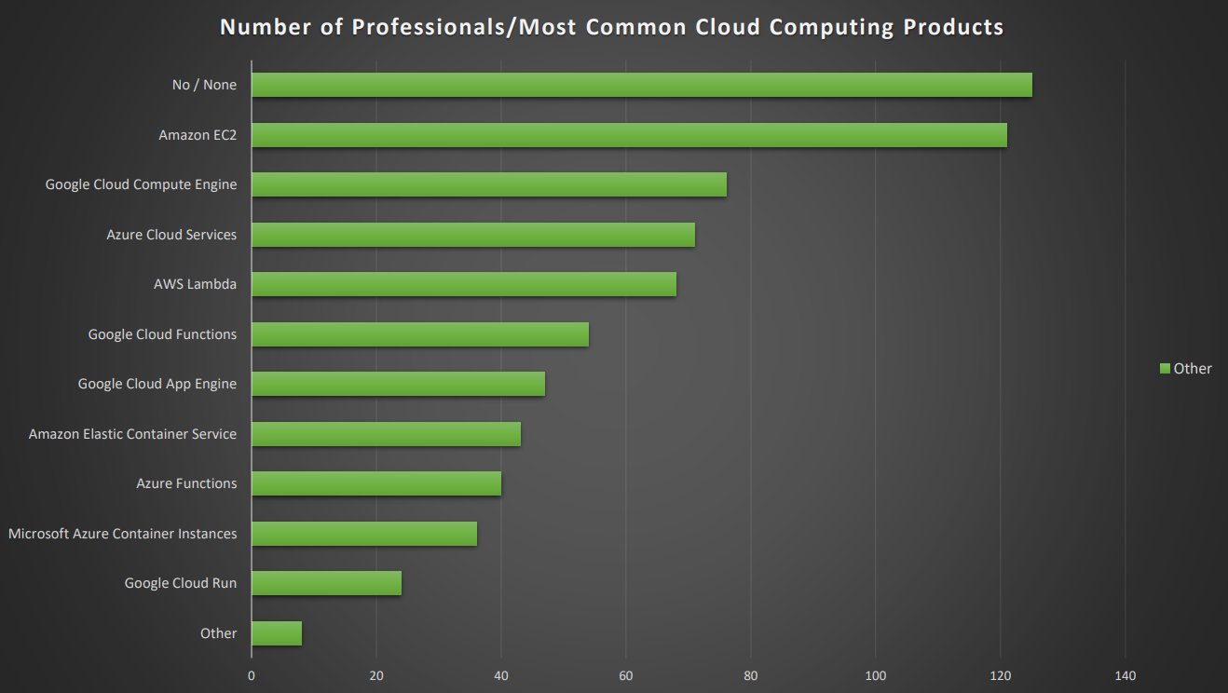

Slide 29
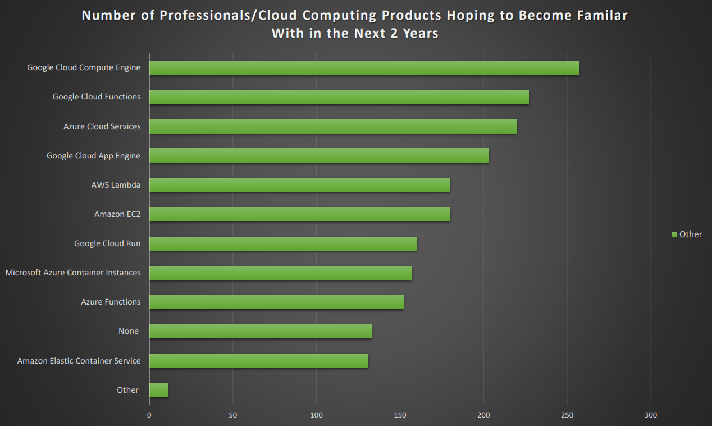

Slide 30
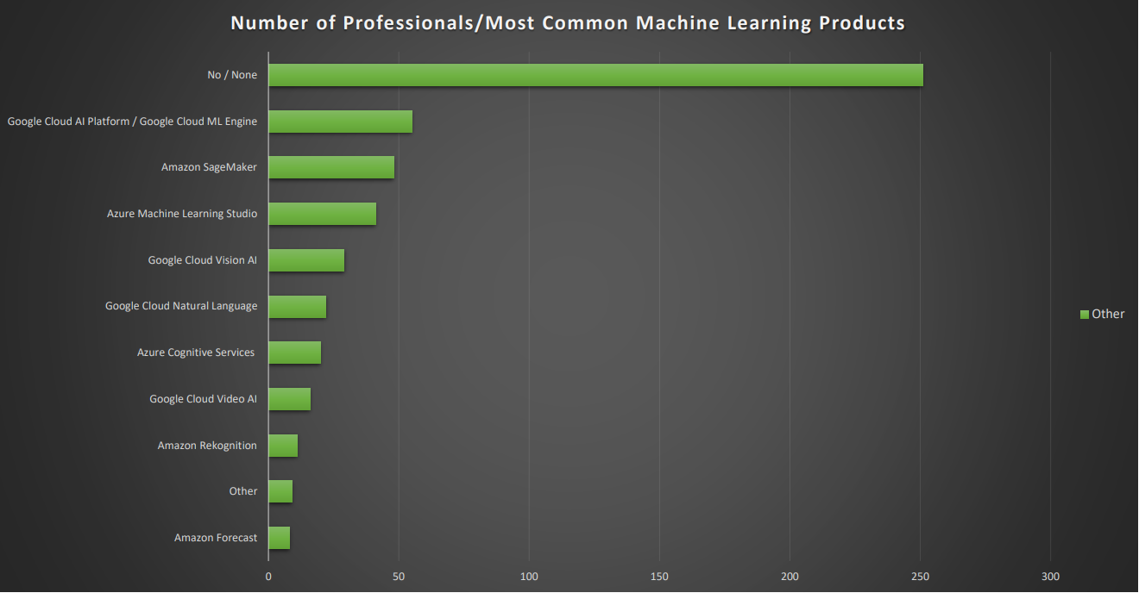

Slide 31
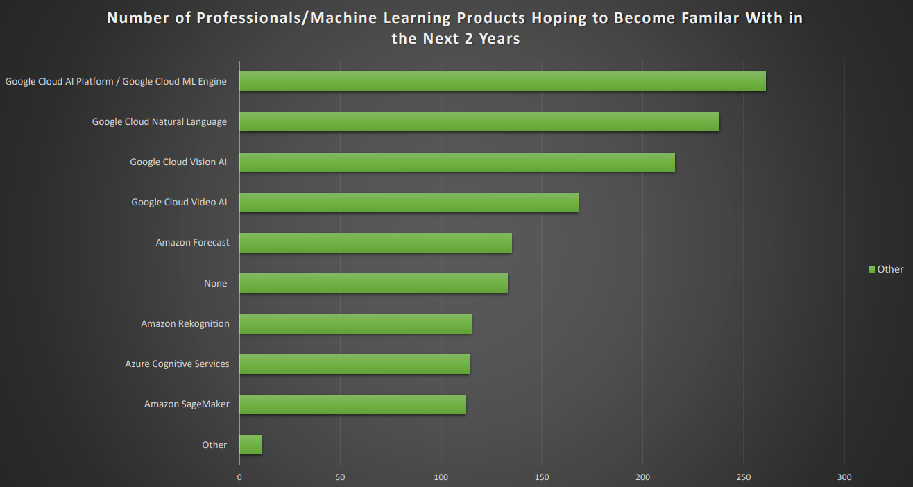

Slide 32
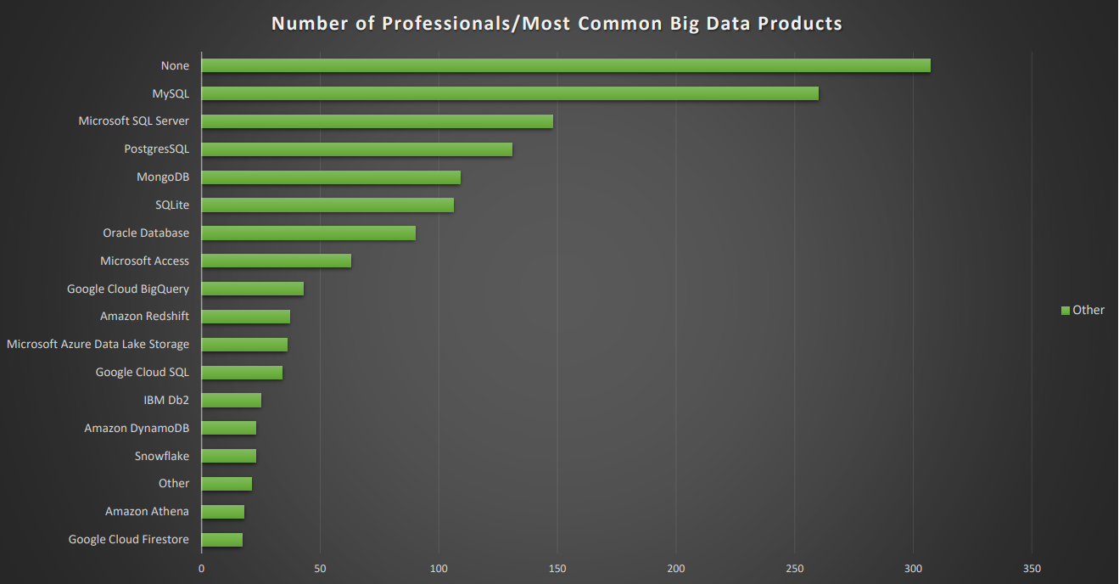

Slide 33
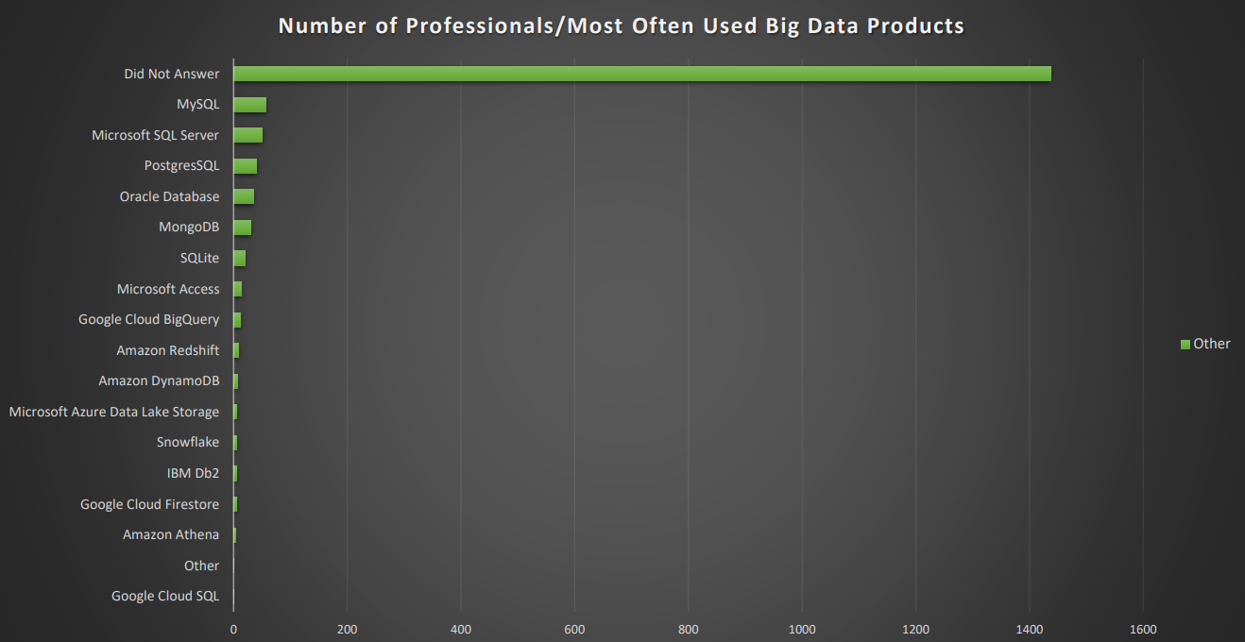

Slide 34
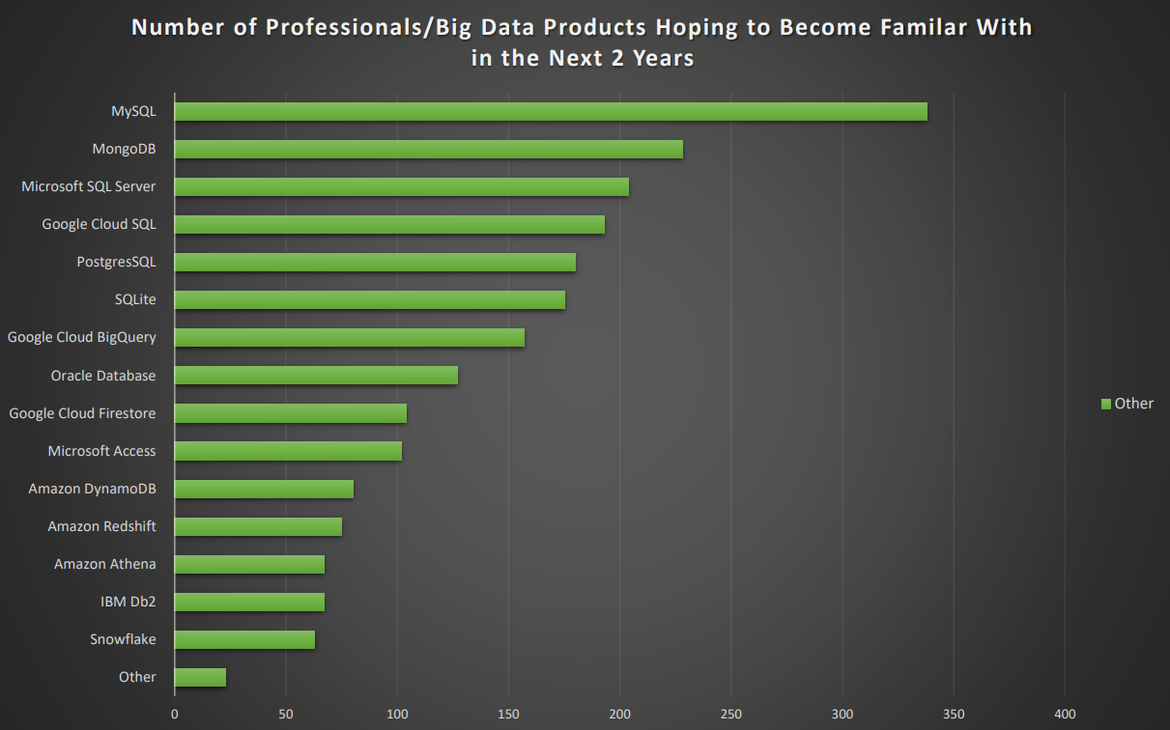

Slide 35
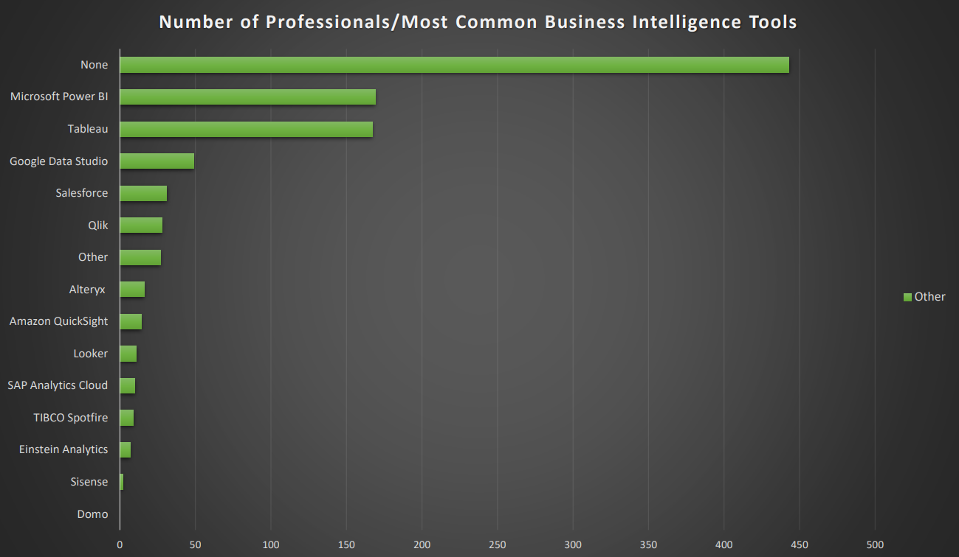

Slide 36
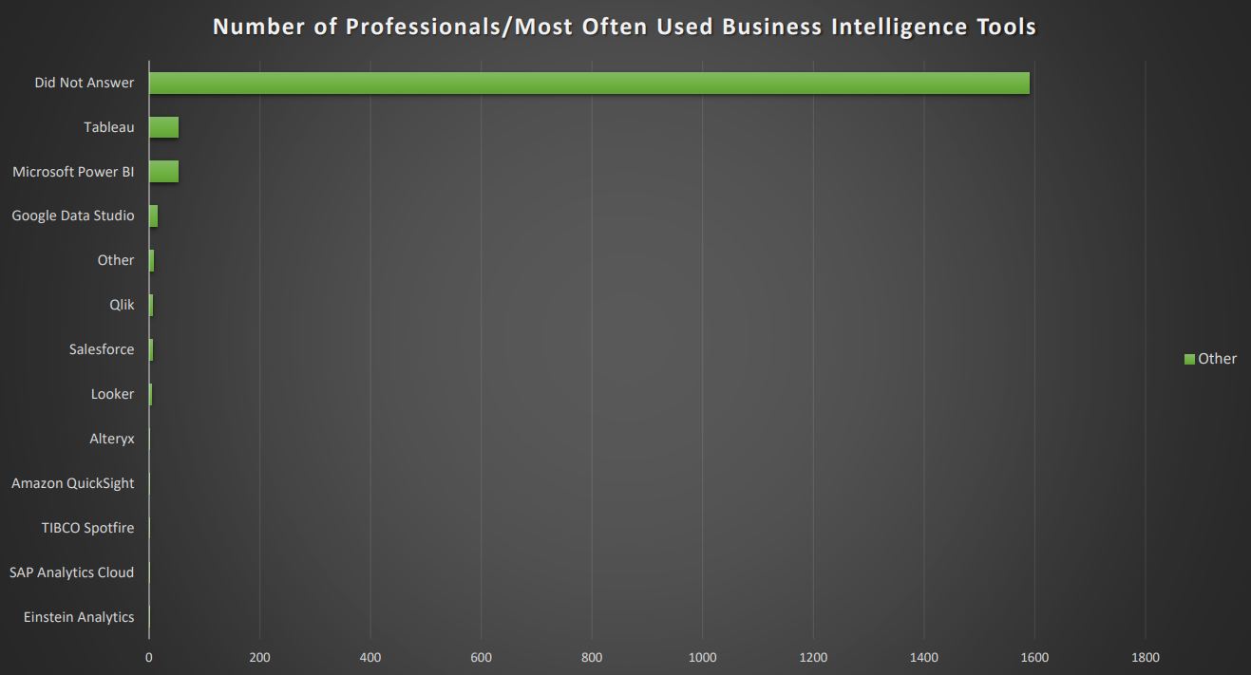

Slide 37
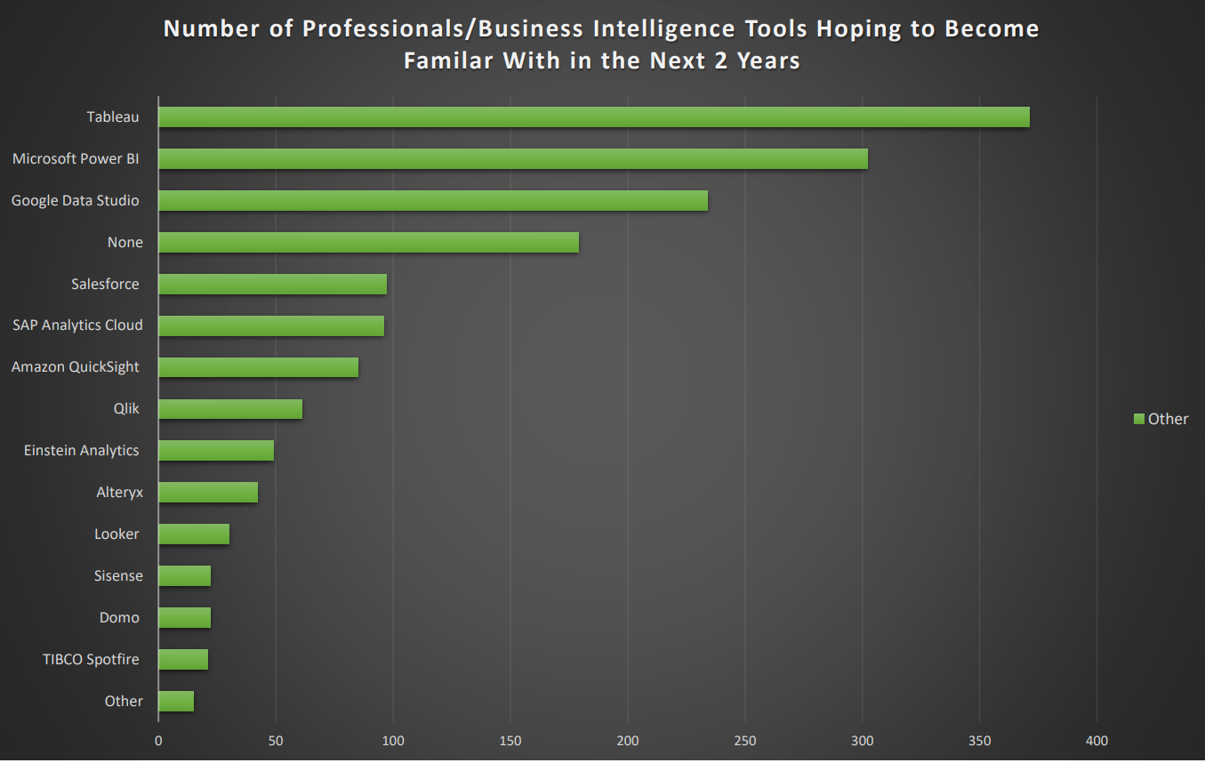

Slide 38
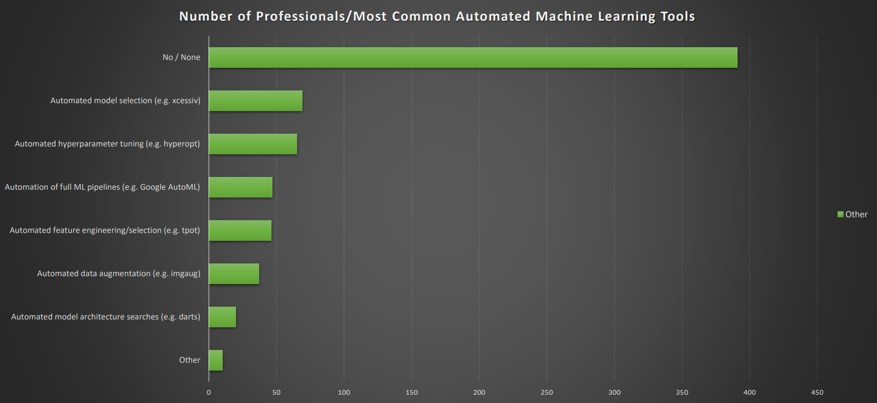

Slide 39
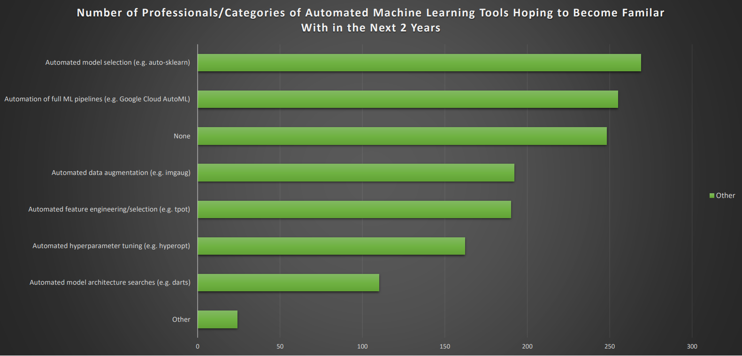

Slide 40
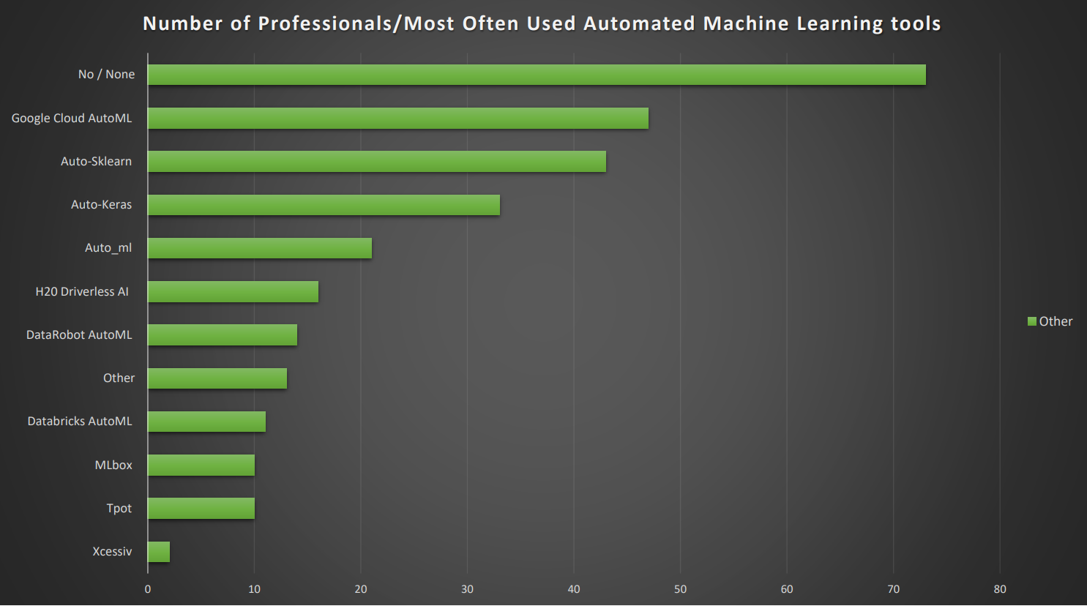

Slide 41
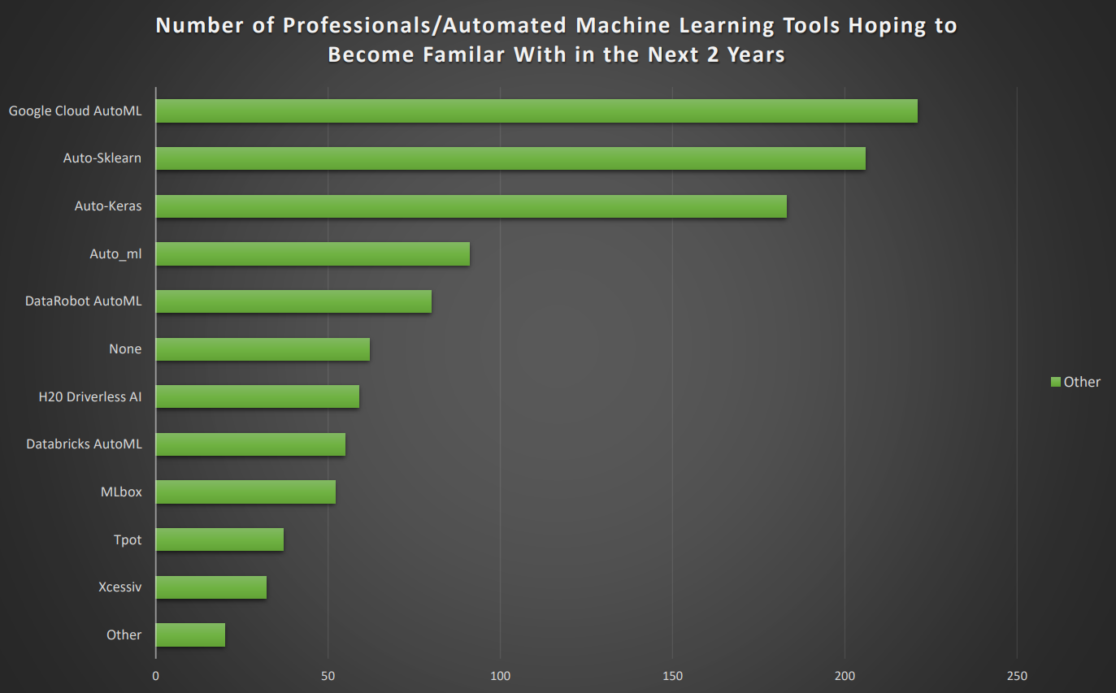

Slide 42
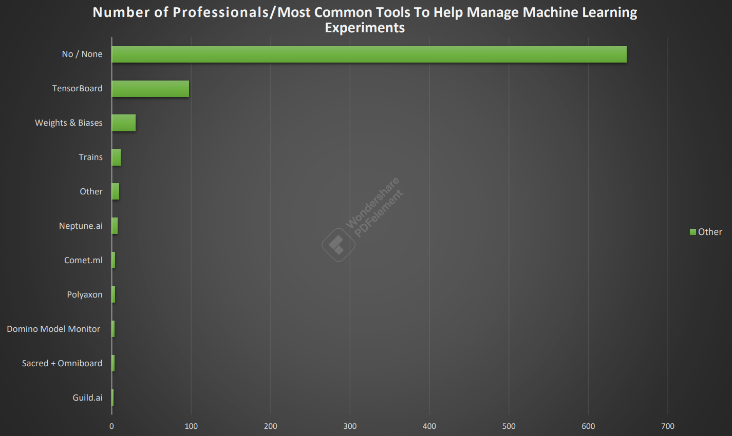

Slide 43
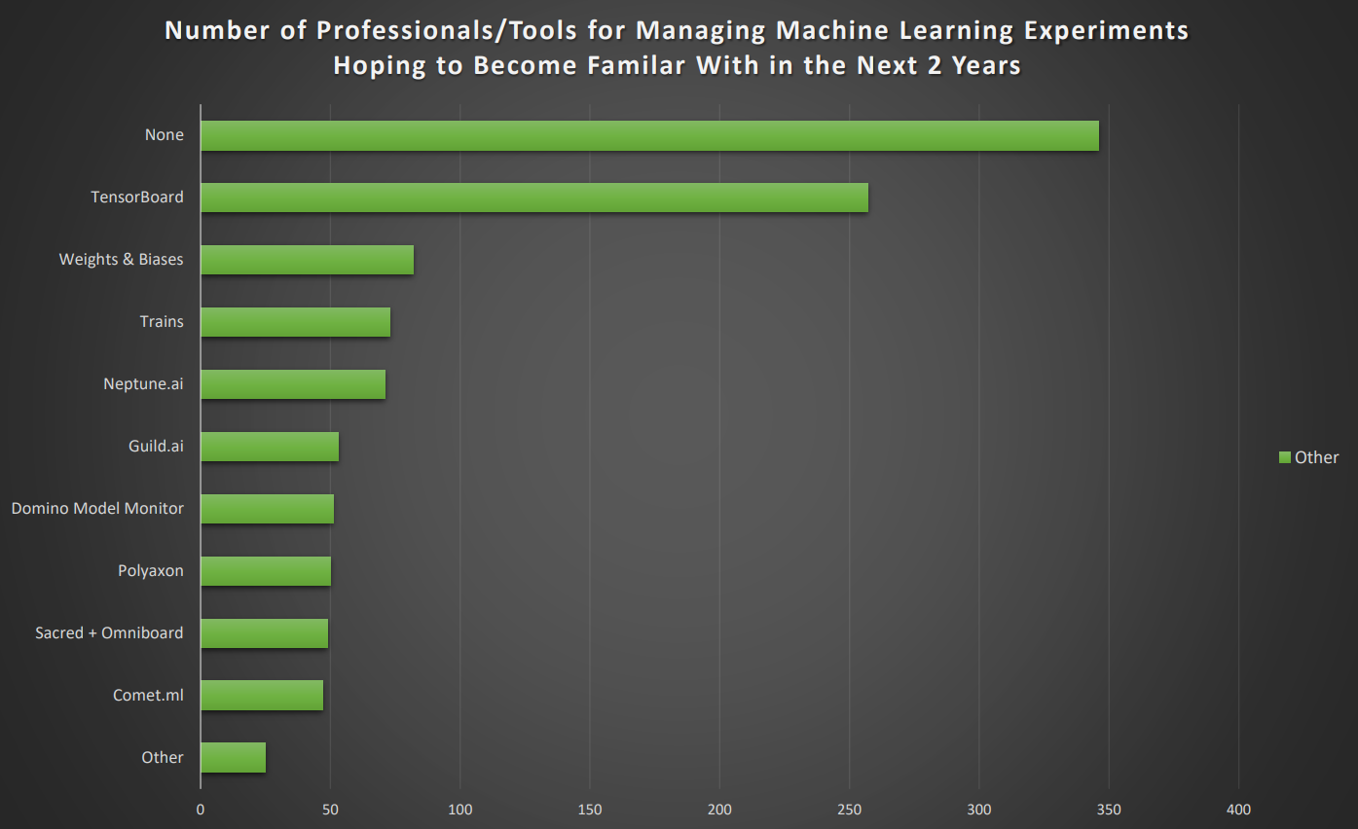

Slide 44
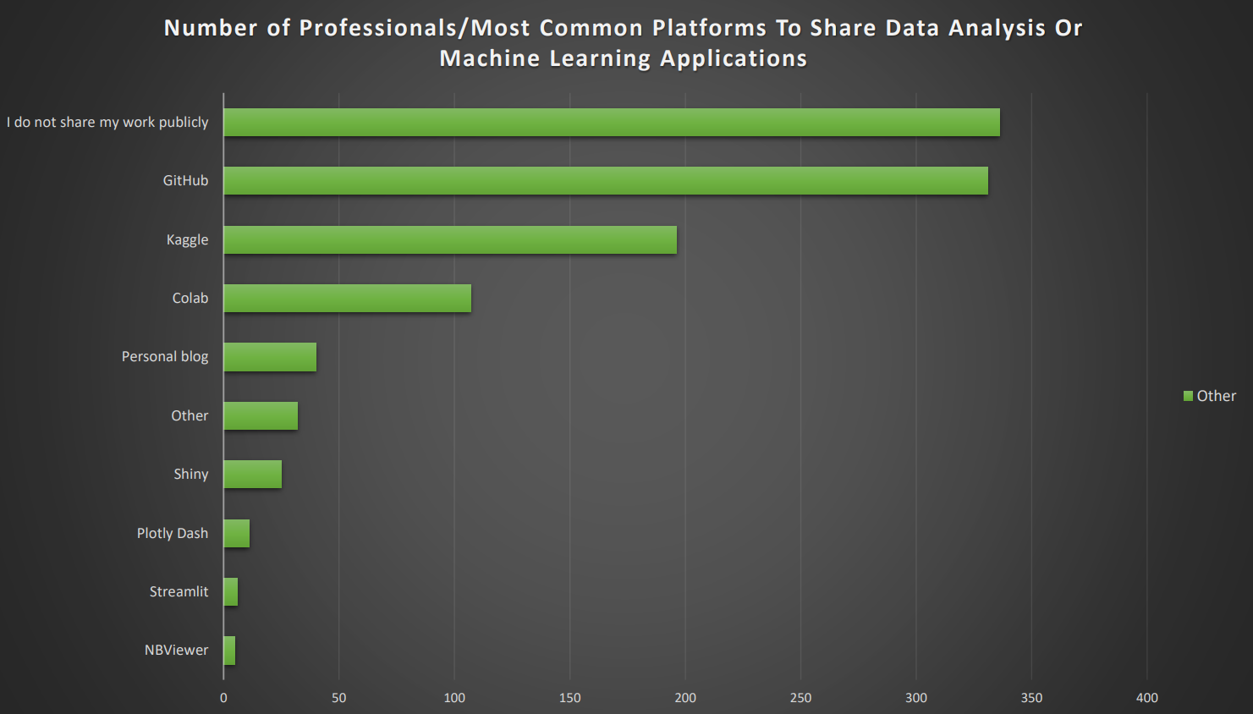

Slide 45
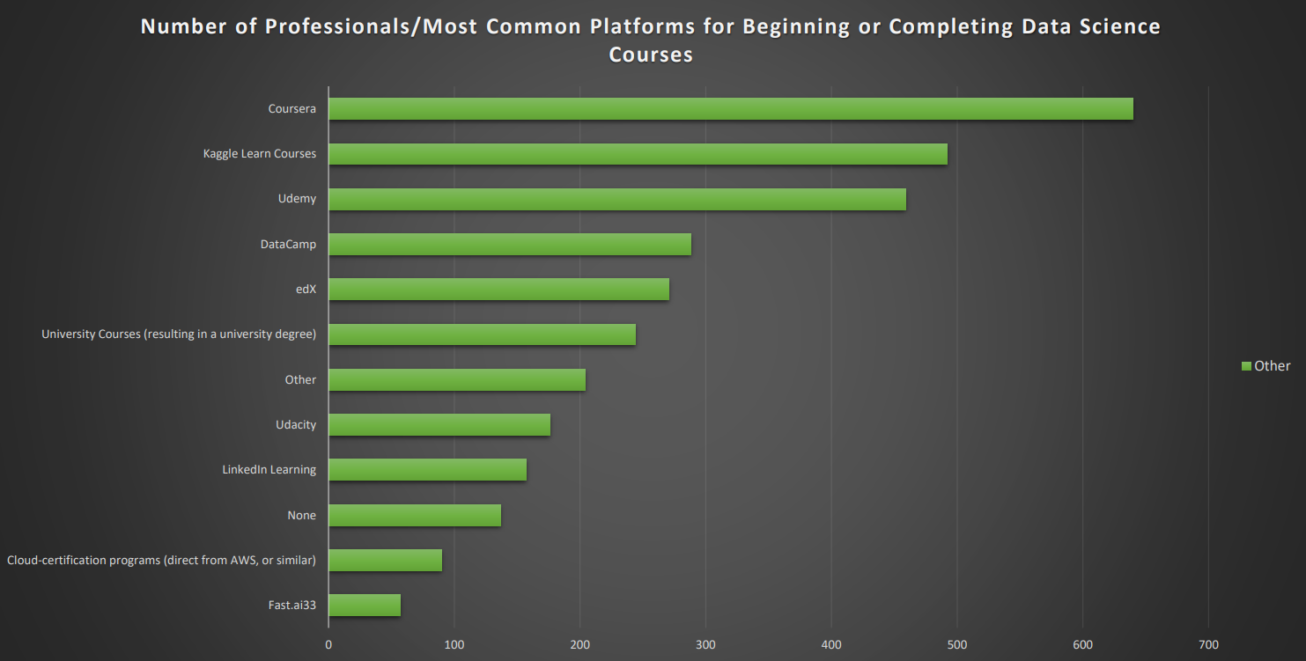

Slide 46
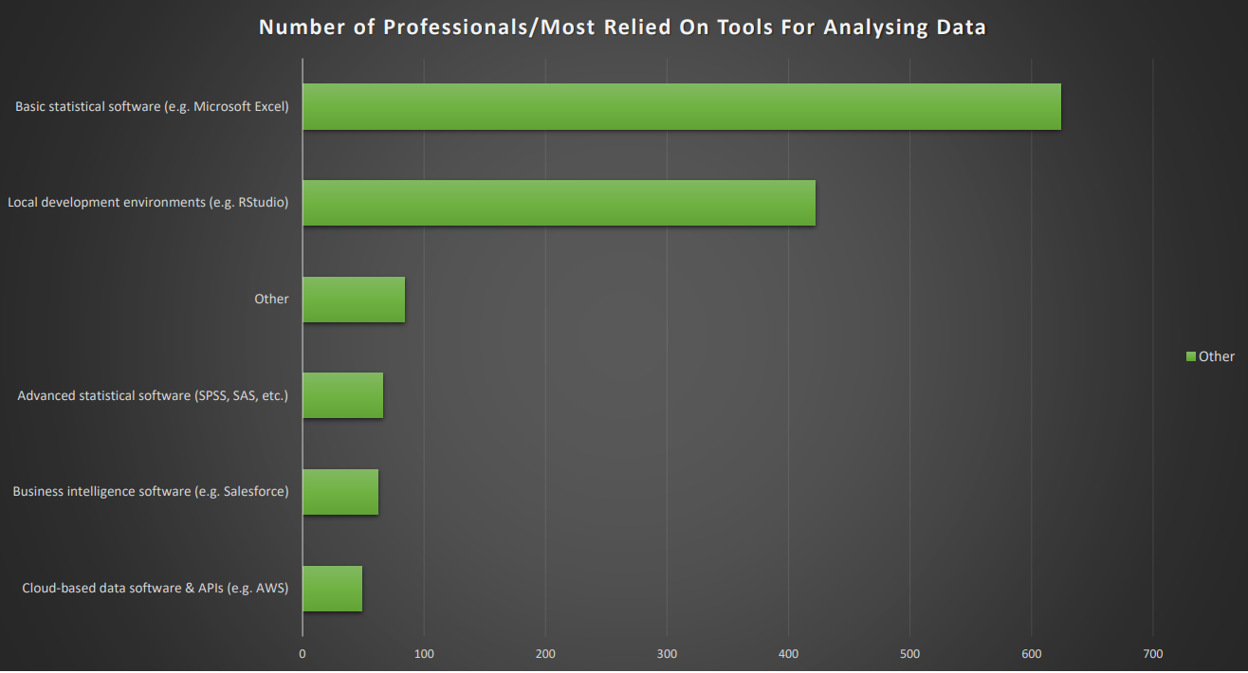

Slide 47
